Slide 1
Behavioral Health for Youth
Hannah Levely
Youth Service’s Coordinator
Department of Mental Health Division of Behavioral Health
Mikala Jungmeyer-Geiger
Youth Services Manager
Missouri Behavioral Health Council

Slide 2
How to Access DBH Services
YBHLS
Crisis Services
Statewide
Accepts Referrals from Schools, Law Enforcement, Juvenile Officers, and other youth-serving agencies.
Full continuum of crisis services is open to everyone. Do not have to be engaged in services prior.
Certified Community Behavioral Health Centers
Statewide
Some Provide Open Access
Accepts Referrals for Services and Walk-Ins for Crisis Care
Notes:
Specific referral services - REACH, CIT, STARR Kids, etc.

Slide 3
Youth Behavioral Health Liaisons (YBHLs)
What is a YBHL?
A Youth Behavioral Health Liaison (YBHL) is a behavioral health professional employed at Community Behavioral Health Clinics (CCBHCs) across the state.
YBHLs support youth experiencing behavioral health challenges by connecting them with necessary services and supports.
YBHLs also focus on providing education on youth behavioral health to local youth-serving organizations, as well as building vital relationships throughout the community.

Slide 4
YBHLs have many roles in their communities...
Link youth and families to appropriate resources.
Coordinate and access resources within the crisis continuum.
Provide training for youth serving organizations on youth behavioral health.
Coordinate services within the local systems of care.
Answer general questions about youth behavioral health.
Notes:
3.1: Target length of stay is 1-3 months. Structured recovery environment. Stable from acute intoxication or withdrawal. 5 hours of services per week.
3.4: 24-hour supportive treatment - impaired functioning (delinquency, JJ involvement, psychological problems, etc.). At least 20 hours of clinical/recovery services per week. Individual counseling, peer support, med services, rehabilitative support, etc.
3.7: 25-hour medical monitoring. 30 hours of structured treatment per week. Moderate or severe SUD.

Slide 5
YBHLs Continued
Who do YBHLs accept referrals from?
YBHLs accept referrals from any youth-serving organization. This includes, but is not limited to, Children’s Division, schools, juvenile offices, courts, law enforcement, and many others.
How do I make referrals?
YBHLs cover the ENTIRE STATE of Missouri, allowing anyone to make a referral. To make a referral you can either contact your local YBHL and provide them with the youth’s information or provide the YBHLs information to the family for them to reach out.

Slide 6
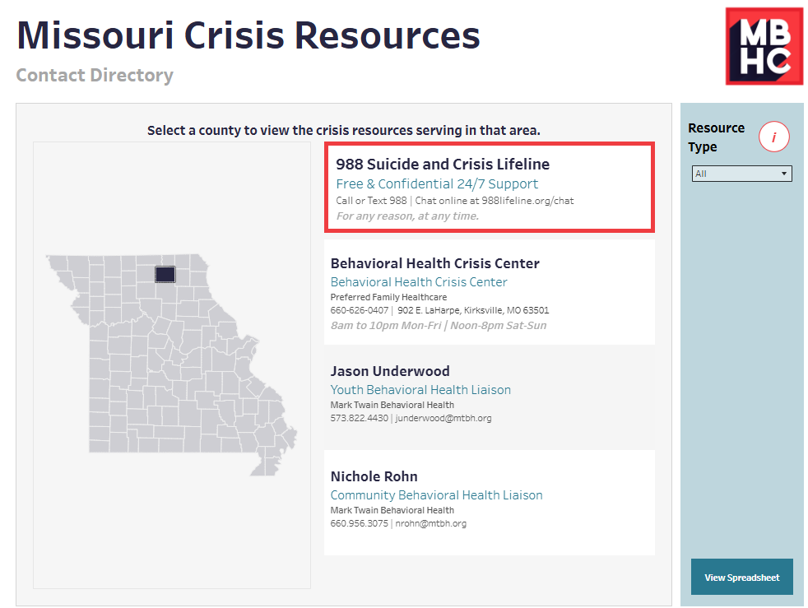

Slide 7
Where are DBH Services Provided?
Certified Community Behavioral Health Clinics (CCBHCs)
Behavioral Health Crisis Centers (BHCCs)
Substance Use Disorder (SUD) Providers
Recovery Support Providers
Various Partnerships (Schools, Law Enforcement, etc.)

Slide 8
CCBHCs
A CCBHC is a specially designated clinic that provides comprehensive mental health and substance use services. These clinics are required to provide treatment to anyone, regardless of their health insurance or ability to pay, place of residence, or age.
CCBHCs were created to:
•Ensure integrated, evidence-based services.
•Provide 24/7 crisis response and medication-assisted treatment.
•Help people access care.

Slide 9
Crisis Services
A youth does not have to be already connected with services to utilize any of these resources.

Slide 10
Youth Continuum of Care
Prevention
Outpatient
Residential
Crisis
School services
Comprehensive Psychiatric Services (CPR)
Comprehensive Substance Treatment and Rehabilitation Services (CSTAR)
988
Mobile Crisis Response Teams
Behavioral Health Crisis Centers

Slide 11
Comprehensive Psychiatric Services
Person-centered approach that emphasizes individual choices and needs.
Promotes independence and the pursuit of meaningful living, working, learning, and leisure activities.
Eligibility
Qualifying Diagnosis
Evidence of Impairment
Duration
Key Service Functions:
•Assessments & Treatment Planning
•Community Support
•Crisis Intervention
•Medication Services
•Physician Consultation
•Outpatient Services
•Psychosocial Rehabilitation

Slide 12
Intensive CPR
Non-Residential
Transitional Age Youth
Evidence-Based Practices (DBT, etc.)
Children’s Inpatient Diversion
Residential
Treatment Family Homes (TFH) – up to 3 youth.
Professional Parent Homes (PPH) – only one youth.
Intensive Residential Treatment (IRTs) – Up to 16 youth.
Psychiatric Individualized Supported Living (PISL) – Up to four youth.
Children’s Inpatient Diversion
Notes:
Specific referral services - REACH, CIT, STARR Kids, etc.

Slide 13
Comprehensive Substance Treatment and Rehabilitation (CSTAR)
Offers a full continuum of care approach to substance use treatment through a combination of clinical and supportive services that differ in duration and intensity, depending on the needs of the consumer.
Eligibility
Diagnosis of a Substance Use Disorder
Key Service Functions:
•Assessments & Medication Services
•Individual, Group, & Family Counseling
•Education & Community Support
•Peer & Family Support
•Families participation in services
•Specialized Treatment Settings

Slide 14
ASAM Levels of Care
Prevention Services
0.5: Early Intervention
Outpatient Services
1: Outpatient Services
2.1: Intensive Outpatient Services
2.5: Partial Hospitalization Services
Residential Services
3.1: Clinically Managed Low-Intensive Residential Services
3.5: Clinically Managed High-Intensity Residential Services
3.7: Medically Monitored Intensive Inpatient Services
Services offered are dependent upon what level of ASAM an individual is enrolled in. Some common services include, but are not limited to:
Individual and Group Counseling
Treatment Planning
Medication Services/Administration
Family Supports
Family Assistance
Community Support
Peer Support
Psychosocial Rehabilitation for Children/Youth
Day Treatment
Crisis Intervention
And Many More.

Slide 15
How can you get involved?

Slide 16
Upstream Mappings
What is Upstream?
A collaborative project to improve the availability, accessibility, and awareness of resources and services for youth and their families. The focus is on each community’s resources and plans of action.
The Missouri Behavioral Health Council is spear-heading Upstream Youth Mapping. They partner with the Missouri Department of Mental Health (DMH), the Office of State Courts Administrator (OSCA), Children’s Division (CD), The National Center for State Courts (NCSC), and the Missouri Juvenile Justice Association (MJJA) to conduct Youth Mapping in Missouri.
Notes:
Specific referral services - REACH, CIT, STARR Kids, etc.

Slide 17
Goals of Upstream
Assess available resources.
Identify gaps/challenges in the community.
Establish action plans for community change.

Slide 18
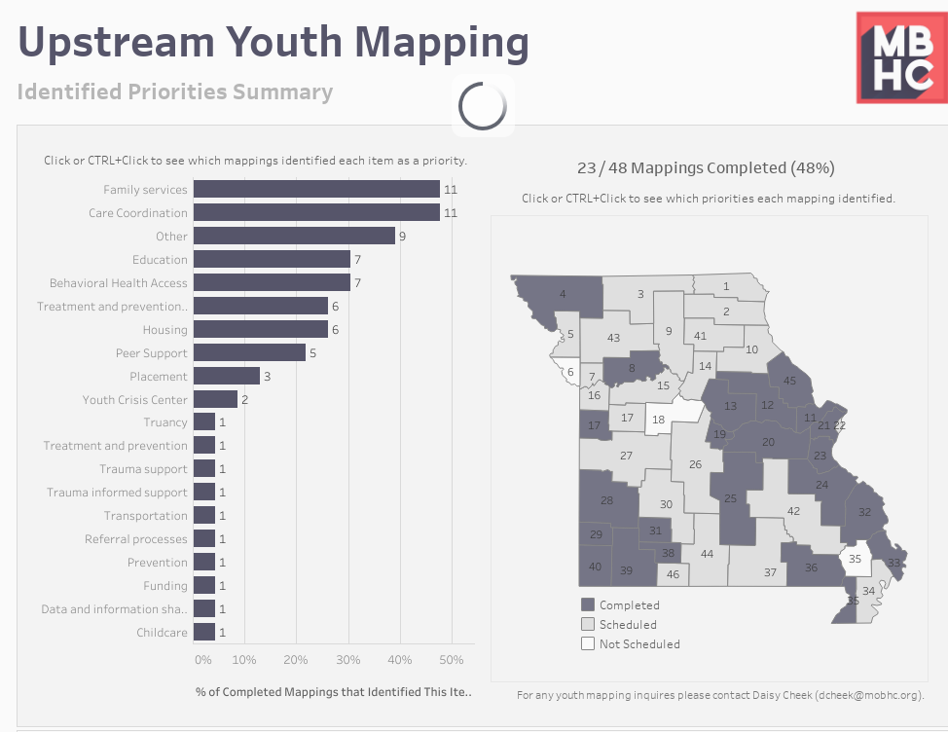
As of March 2025

Slide 19
The Importance of Upstream
Different perspectives.
Facilitation of conversation by a neutral third party.
Open forum.
Solution and action-focused.
Connection with other community members.
Notes:
3.1: Target length of stay is 1-3 months. Structured recovery environment. Stable from acute intoxication or withdrawal. 5 hours of services per week.
3.4: 24-hour supportive treatment - impaired functioning (delinquency, JJ involvement, psychological problems, etc.). At least 20 hours of clinical/recovery services per week. Individual counseling, peer support, med services, rehabilitative support, etc.
3.7: 25-hour medical monitoring. 30 hours of structured treatment per week. Moderate or severe SUD.

Slide 20
Want to attend an Upstream Mapping?
Daisy Ellis
Youth Services & Referral Manager
Missouri Behavioral Health Council
dellis@mobhc.org
573-634-4626 x 127

Slide 21
Youth Mental Health First Aid
For school staff.
Focused on providing the skills you need to reach out and provide initial support to a youth who may be developing a mental health or substance use challenge.
Teach you how to:
Assess for risk of suicide or harm.
Listen nonjudgmentally.
Give reassurance and information.
Encourage appropriate professional help.
Encourage self-help and other support strategies.
MHFA Missouri – Identify. Understand. Respond: https://mhfamissouri.org.
Notes:
Specific referral services - REACH, CIT, STARR Kids, etc.

Slide 22
Teen Mental Health First Aid
For teens in grades 9-12, or ages 14-18.
Teaches youth how to identify, understand, and respond to mental health and/or substance use challenges in their friends and peers.
Teaches skills focused on how to recognize the signs and symptoms of a developing crisis, and how to get help from a trusted adult.
Teen MHFA – MHFA Missouri: https://mhfamissouri.org/tmhfa/

Slide 23
Mikala Jungmeyer-Geiger
Youth Services Manager
Missouri Behavioral Health Council
mjungmeyer@mobhc.org
573.634.4626 ext.115
Hannah Levely
Youth Service’s Coordinator
Division of Behavioral Health
Hannah.Levely@dmh.mo.gov
573-508-2782

